Slide 1
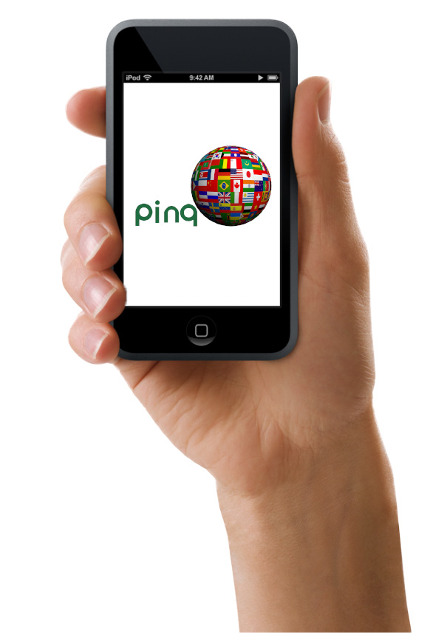


Slide 2
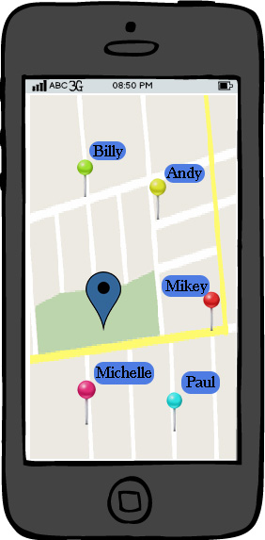
This is the main screen of the app
It shows the current location of the user and other ping users around the user, with their usernames.
The user can touch the other users to send a message or he can zoom in or out.
He can pulls the search tab from the top of the screen.

Slide 3
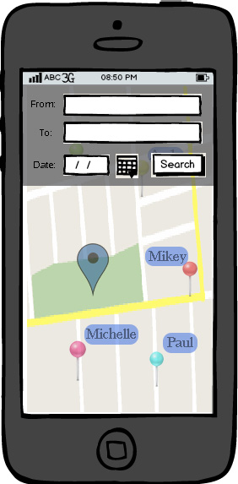
Here is the search tab of the app.
The user enters the location and the destination with the date and time and searches that who is going or passing from that route.
The map is active at the backround, the opticality is a bit low.

Slide 4
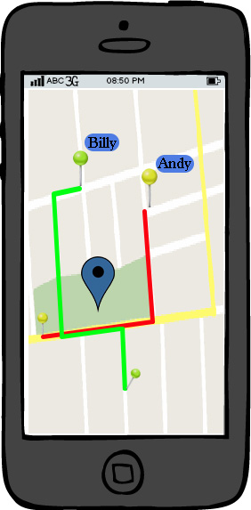
After the user enters the route, the app shows other users passing or going to the same direction.
The user can tap on the user to send a message.

Slide 5
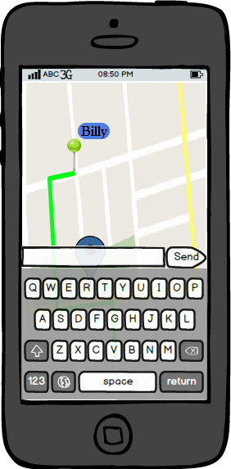
When he taps on a user to send a message, the other options dissapear.
The map is active in the background.

Slide 6
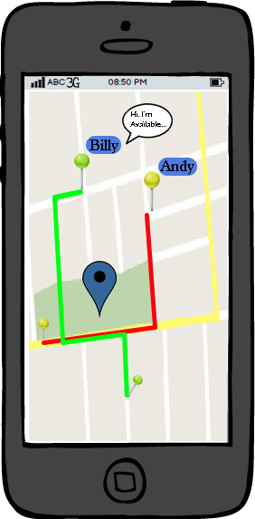
If a message comes from the other users, a baloon appears on the icon.
The user can tap on the baloon to see the message

Slide 7
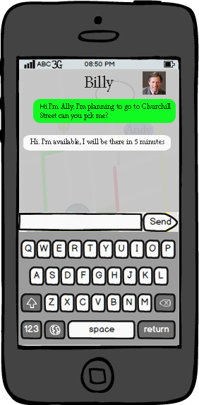
Here is the chat screen between the user
It is a bit transparent and the map is still active on the background.
There is also a profile picture of the other user.

